Slide 2
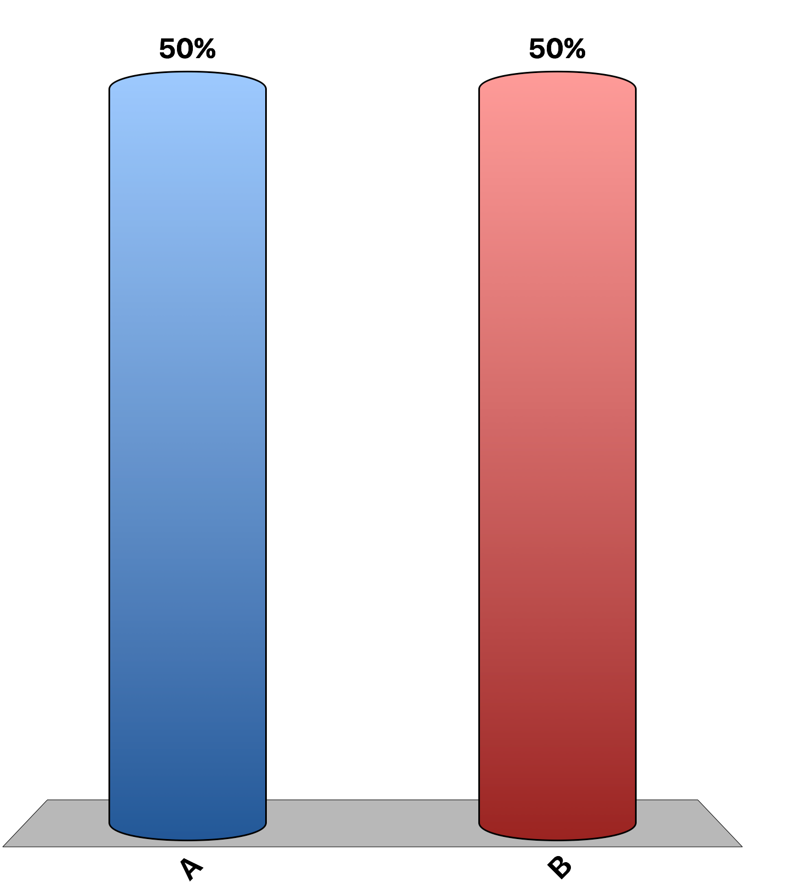
Externalities can be negative or positive.
True
False

Slide 3
Government solutions to negative externalities are always more efficient than private solutions.
True
False

Slide 4
You live in a building that allows smoking inside. Your roommate values smoking in the apartment at $100 and you value clean air at $200. According to Coase, you can pay your roommate $101 and he will smoke outside.
True
False

Slide 5
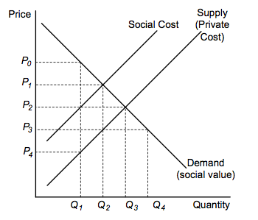
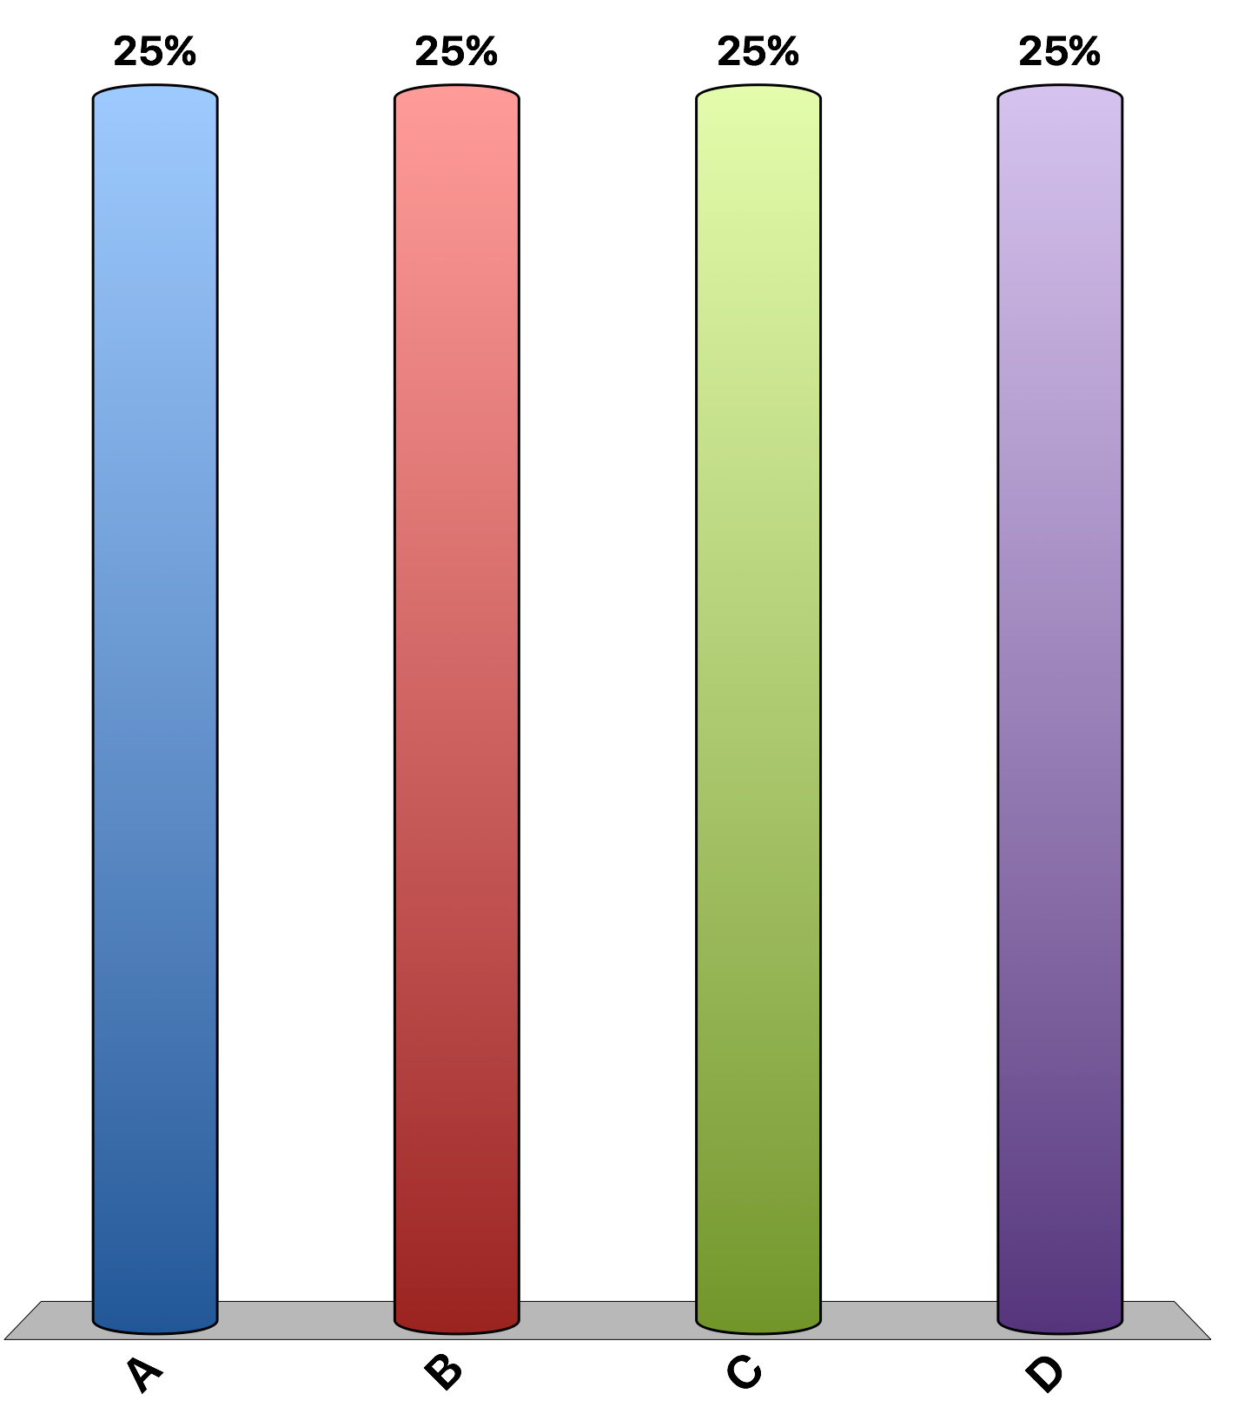
Refer to the figure. The socially optimal level of output is
Q₁.
Q₂.
Q₃.
Q₄.

Slide 6
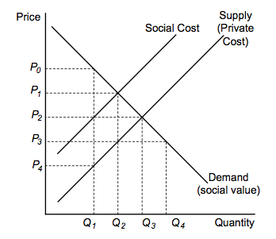
Refer to the figure. Which of the following would improve economic efficiency in the market?
a tax equal to P₁ - P₃, the size of the marginal external cost
a tax equal to P₀ - P₄, the size of the marginal external cost
a subsidy equal to P₁ - P₃, the size of the marginal external benefit
a subsidy equal to P₀ - P₄, the size of the marginal external benefit

Slide 7
If a positive externality exists in the market for flu shots, the private market equilibrium occurs at a price that is
too low and a quantity that is too low in comparison to the socially optimal equilibrium.
too high and a quantity that is too low in comparison to the socially optimal equilibrium.
too low and a quantity that is too high in comparison to the socially optimal equilibrium.
the same as the socially optimal equilibrium.

Slide 8
According to the Coase theorem, private parties can
solve positive externality problems more easily than negative externality problems.
minimize transactions costs through private bargaining.
solve externality problems through taxes.
solve externality problems through private bargaining.

Slide 9
The students living in “The Party House” are prone to host loud parties on Saturday night. They value these celebrations at $100. Their studious neighbors value peace and quiet at $90. The noise ordinance in this college town requires the police to stop loud parties if the neighbors complain. Assume zero transaction costs. An efficient solution for this problem would be for
The Party House to pay the neighbors $91 to not call the police.
The Party House to quit the loud parties.
The Party House to invite the neighbors to one of the parties.
The neighbors to pay the Party House $99 to be quiet.

Slide 10
The citizens of Knoxville are complaining that the two pickle-makers in town, ‘Crunchy Ponds pickles’ and ‘Sweet Rose pickles’, are polluting the environment. Currently, each pickle-maker emits 20 tons of pollution per year. ‘Crunchy Ponds pickles’ could clean the pollution at a cost of $500 per ton. ‘Sweet Rose pickles’ could also clean the pollution, but a cost of $1,100 per ton. In an effort to reduce pollution, the government of Knoxville decrees that from now on, each pickle factory has to reduce pollution to 10 tons per year each, or else. What is the cost of reducing pollution to the desired levels?
total cost of cleaning 20 tons of pollution is $10,000 per year; it costs ‘Crunchy Ponds pickles’ $1,000 to clean 10 tons of pollution; it costs ‘Sweet Rose pickles’ $9,000 to clean 10 tons of pollution.
total cost of cleaning 20 tons of pollution is $14,000 per year; it costs ‘Crunchy Ponds pickles’ $4,000 to clean 12 tons of pollution; it costs ‘Sweet Rose pickles’ $10,000 to clean 12 tons of pollution.
total cost of cleaning 20 tons of pollution is $16,000 per year; it costs ‘Crunchy Ponds pickles’ $5,000 to clean 10 tons of pollution; it costs ‘Sweet Rose pickles’ $11,000 to clean 10 tons of pollution.
total cost of cleaning 20 tons of pollution is $18,000 per year; it costs ‘Crunchy Ponds pickles’ $6,000 to clean 12 tons of pollution; it costs ‘Sweet Rose pickles’ $12,000 to clean 12 tons of pollution.

Slide 11
The citizens of Knoxville are complaining that the two pickle-makers in town, ‘Crunchy Ponds pickles’ and ‘Sweet Rose pickles’, are polluting the environment. Currently, each pickle-maker emits 20 tons of pollution per year. ‘Crunchy Ponds pickles’ could clean the pollution at a cost of $500 per ton. ‘Sweet Rose pickles’ could also clean the pollution, but a cost of $1,100 per ton. In an effort to reduce pollution, the government of Knoxville gives each pickle factory 10 tradable pollution permits. Each tradable pollution permit allows the owner to emit one ton of pollution, and its market value is $800. What is the cost of reducing pollution to the desired levels? How is this possible?
total cost of cleaning 20 tons of pollution is $10,000 per year. ‘Crunchy Ponds pickles’ cleans 20 tons of pollution after selling 10 pollution permits to ‘Sweet Rose pickles’
total cost of cleaning 20 tons of pollution is $14,000 per year. ‘Sweet Rose pickles’ cleans 20 tons of pollution after selling 10 pollution permits to ‘Crunchy Ponds pickles’
total cost of cleaning 20 tons of pollution is $16,000 per year. ‘Sweet Rose pickles’ cleans 20 tons of pollution after selling 10 pollution permits to ‘Crunchy Ponds pickles’
total cost of cleaning 20 tons of pollution is $18,000 per year. ‘Crunchy Ponds pickles’ cleans 20 tons of pollution after selling 10 pollution permits to ‘Sweet Rose pickles’

Slide 12
The most efficient pollution control system would ensure that
each polluter reduce its pollution an equal amount.
those polluters with lowest cost of pollution abatement reduce their pollution most.
regulators decide how much each polluter must reduce its pollution.
no new pollution of the environment be allowed.

Slide 13
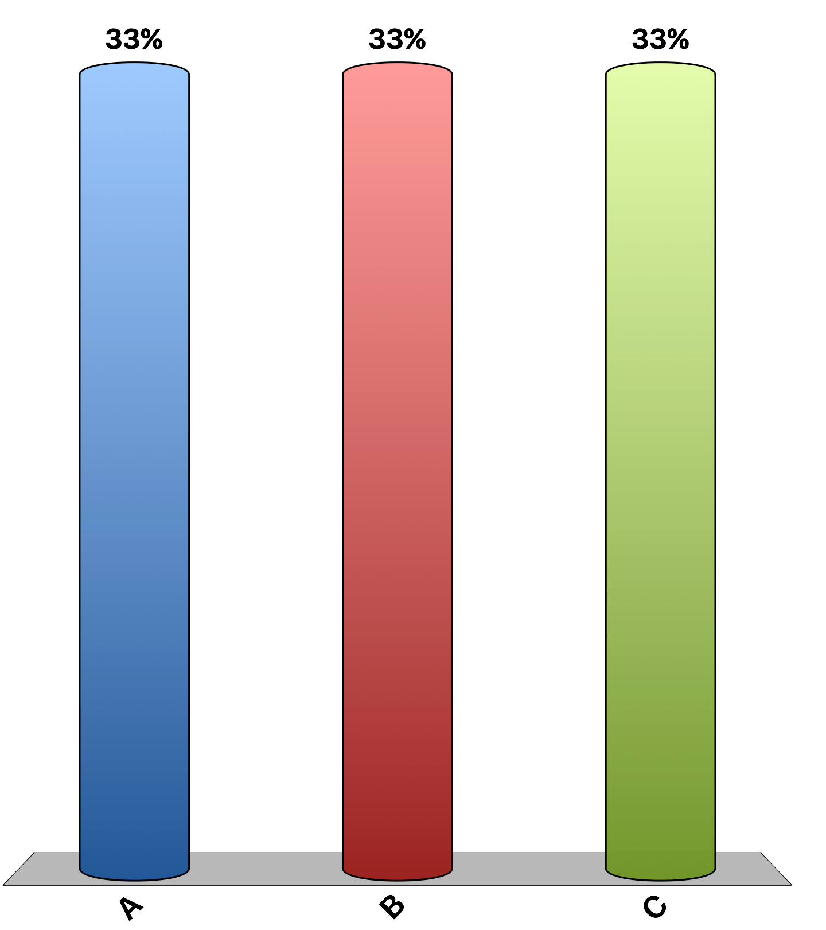
“Declining to be vaccinated against contagious diseases such as measles imposes costs on other people, which is a negative externality.”
agree
disagree
uncertain
Notes:
100% of economists agree with this statement. This is the 'Ask the experts' feature in the textbook. Source: IGM Economic Experts Panel, March 10, 2015.

Slide 14
“A tax on the carbon content of fuels would be a less expensive way to reduce carbon-dioxide emissions than would a collection of policies such as ‘corporate average fuel economy’ requirements for automobiles.”
agree
disagree
uncertain
Notes:
95% of economists agree, 2% disagree, and 3% are uncertain. This is the 'Ask the experts' feature in the textbook. Source: IGM Economic Experts Panel, December 4, 2012 and December 20, 2011.

